Slide 1
Literary Road Trips: GIS and Digital Mapping Tools
NEALLT 2016
Motivating Students with Media, Games, and Style
Gettysburg College
March 18-20
Luba Iskold
Muhlenberg College

Slide 2
Presentation Outline
Background
Why use Literary Road Trips?
Software Options
Examples of Student Work
Student Guide
Project Demo
Findings from Student Surveys
Discussion & Conclusions

Slide 3
Research on New Literary Hybrids in the Age of MM Expression
Maps present a means of visualization of knowledge
The sense of territory, frontier & place is powerful on the Internet
It is amplified by the development of global positioning technologies that allow to experience reality in virtual spaces
The convergence of technology & culture explains the trend toward “geospatial Humanities”
Fundamental types of literary maps:
  Separate literary works
  Real & fictional routs of particular writers
  Global positioning of a national literature
  Literary places in different cities & regions
  Fictional space in literary works/fantasy worlds

Slide 4
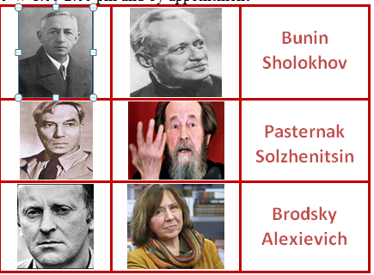
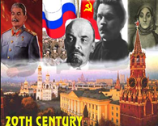
Why Literary Road Trips?
Purpose of the Project
to help students with visualizing literary texts in their geographical, historical, political, and cultural contexts
Geographical locations
Historical events relevant to the plot
Everyday cultural practices
Cultural artifacts

Slide 5
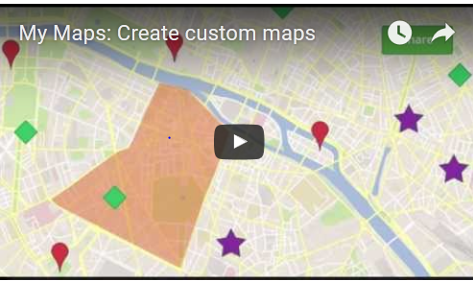
Mapping Tools: Google MyMaps
What can we do with Google MyMaps?
Create a map, draw lines, shapes, or place marks on it
Import geographically-specific data: address or coordinates
Organize the map with layers to hide or show content

Slide 6
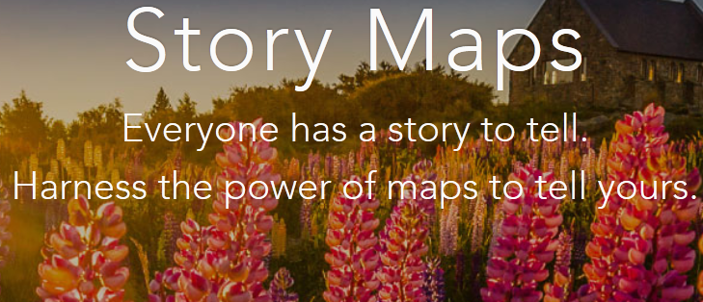
Mapping Tools: ArcGIS Story Maps
ArcGIS Story Maps combine maps with text, images & MM
Story Maps can be used for virtual tours, travelogues
Story Maps Gallery with a large collection of examples

Slide 7
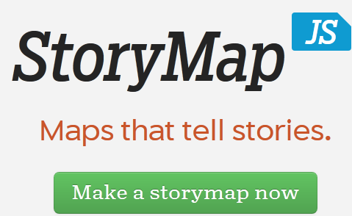
Mapping Tools: Night Lab StoryMapJS
Night Lab StoryMapJS -free tool
Highlights locations of events
Main features:
  Gigapixel - can tell stories with large photographs, works of art, historic maps, and other image files
  SnapMap - helps create a StoryMap
  Places 20 most recent geo-tagged Instagrams on a map
  Can be shared instantly
  Can be edited in StoryMap's authoring tool, adding media from other sources

Slide 8
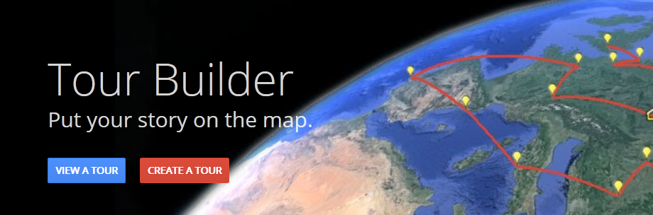

Mapping Tools: Tour Builder Beta
Tour Builder Beta (a Google Earth Experiment)
• Shows the places visited & the experiences had
• Uses Google Earth
• Allows to pick the locations right on the map, add in photos, text, and video, and then share with others
$$∙$$

Slide 9

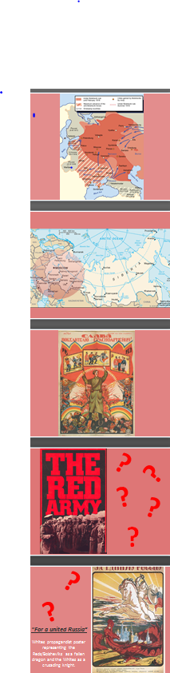
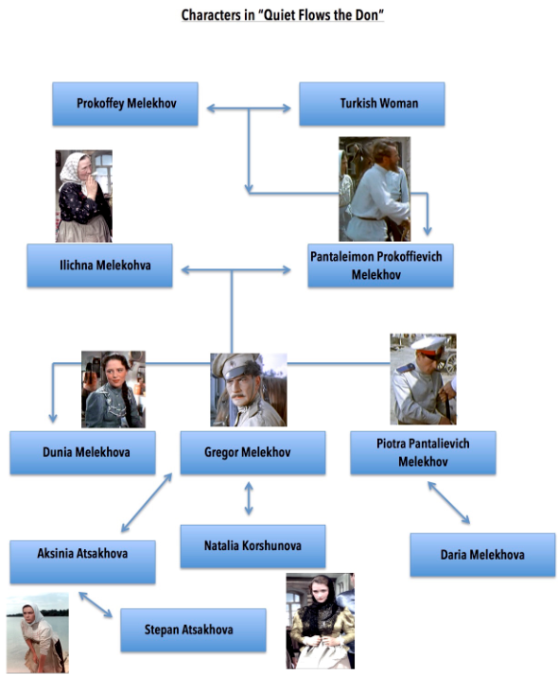
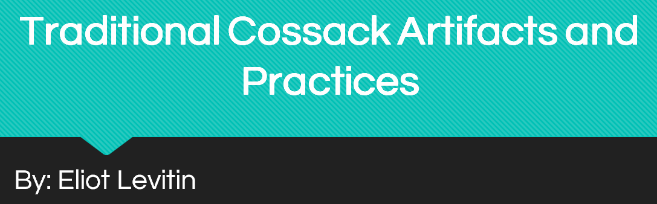

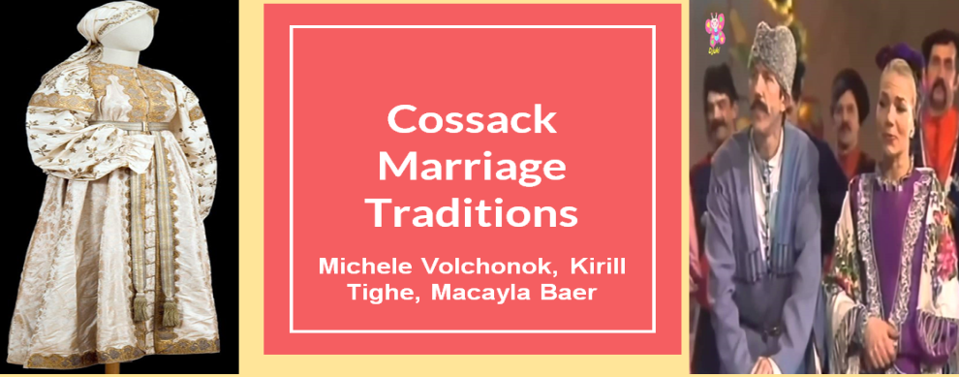
Examples of Student Work

Slide 10
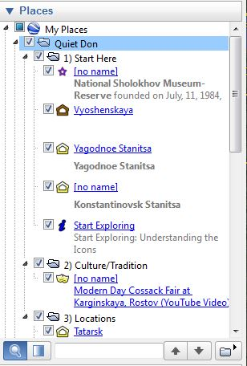
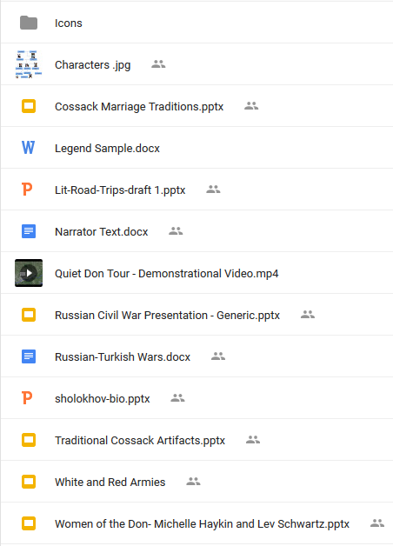
And Quiet Flows the Don Virtual Tour:
Student Research

Slide 11
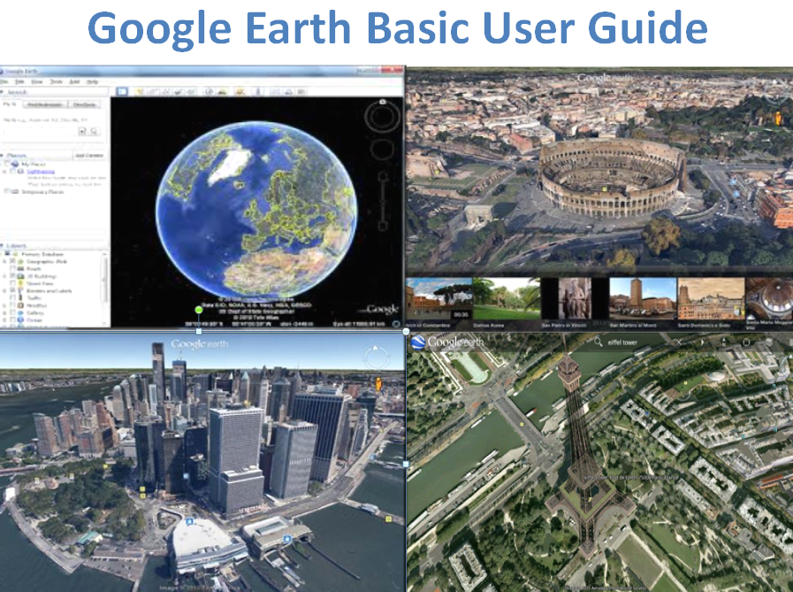
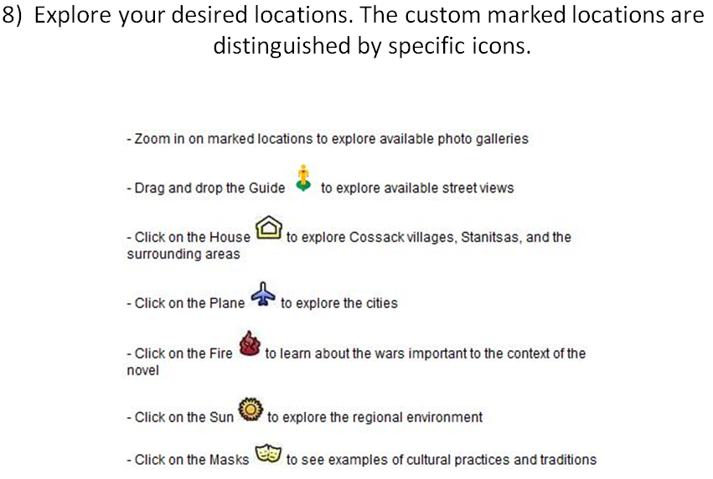
User Guide:

Slide 12
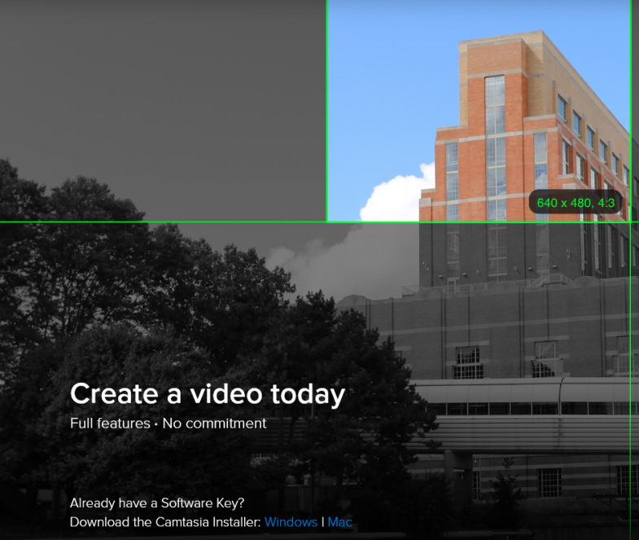
Video Recording: CamTasia Studio
Camtasia
Lets to produce/edit videos in one app
Records on-screen activity
Adds imported media
Creates interactive content
Allows sharing high-quality HD video

Slide 13

Literary Road Trip: Quiet Don Demo

Slide 14
Exit Student Survey
Judgments were made on a 5-point scale (5 = strongly agree, 1 = strongly disagree); n = 14
Question | Mean
My work on the project helped me 1. Understand specific aspects of the Cossack culture better | 4.44
2. Understand the historical context of the Quiet Don better | 4.44
3. Spend more time thinking about the assigned topic | 4.63
4. Consumed too much time relative to other assignments | 2.22
5. Learn from my peers in class | 4.33
6. Overall, the Literary Trip project is useful for RUS 402 | 4.52
7. My collaborative work with a partner(s) was productive | 4.00
8. I am interested in using Google Earth with other readings | 4.22
9. The project can be expanded in the future | 4.63

Slide 15
Academic Benefits
  Students:
  Collaborated with peers
  Integrated peers’ perspectives into own learning experience
  Spent more time on the assigned topic
  Developed critical thinking skills
  Were motivated since they knew others will see their work
  Uploaded images, PPTs, PDFs, web links, video
  Faculty:
Materials can be:
Accessed online
Edited & expended in the future
Used for flipped/hybrid/online teaching

Slide 16
Discussion: How can we use
Literary Road Trips Effectively?
Use projects that support course objectives
Develop brief tasks tied to topics covered in class
Explain the connection to students
Discuss upcoming projects and potential problems
Specify expected quality of student submissions
Consider showing/discussing projects in class
Ask students to evaluate what makes a good virtual tour

Slide 17
Contact Information:
Luba Iskold
Professor of Russian
Director Language Learning Center
Muhlenberg College
Phone: 484-664-3516
E-mail:
iskold@muhlenber.edu

