Slide 1
Department of Languages, Literatures and Cultures
Enhancing Teaching & Learning with Technology
Presented by:
Luba Iskold
Director, Language Learning Center
Farid Khan
Presidential Assistant, Language Learning Center
August 23rd, 2013

Slide 2
Presentation Outline
Creating & Using QR codes
Google Earth Tours
Blended Learning
Flipped Classroom Approach

Slide 3
Understanding QR Codes
What is a QR code?
Examples of Use:
Brochures & Flyers
LLC Poster Exhibit
Display Cases

Slide 4
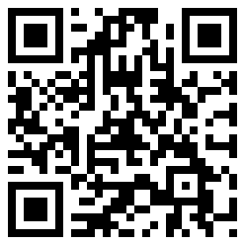
What is a QR Code?
Abbreviation for Quick Response - QR
Advanced matrix or two-dimensional bar code
Features:
Fast readability
Instant access
No need to type the URL
http://en.wikipedia.org/wiki/QR_code

Slide 5
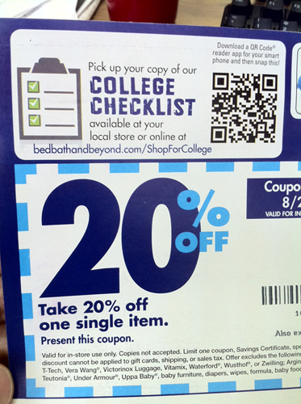
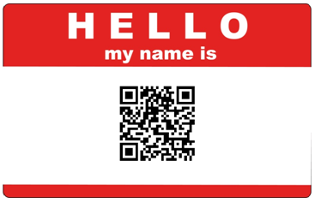
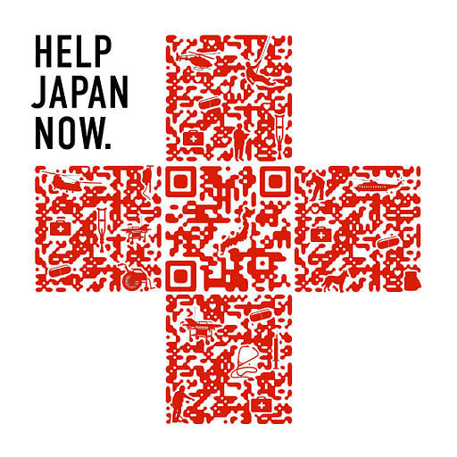
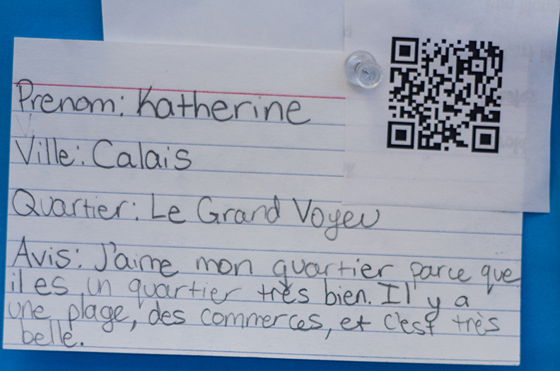

Where are QR Codes Used?
Examples:
Advertising
Coupons
Guided tours
Creative name tags
Education

Slide 6
How to use any QR Code Reader?
Download a QR reader from the App Store on your phone
Example RedLaser and QuickMark for iOS and Android
Focus your camera on the QR code
The app returns the decoded text or web URL

Slide 7
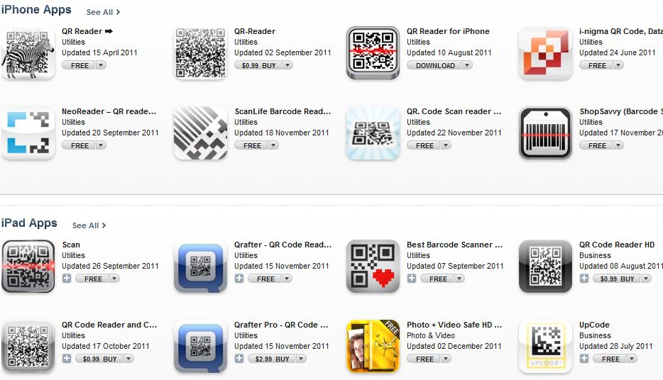
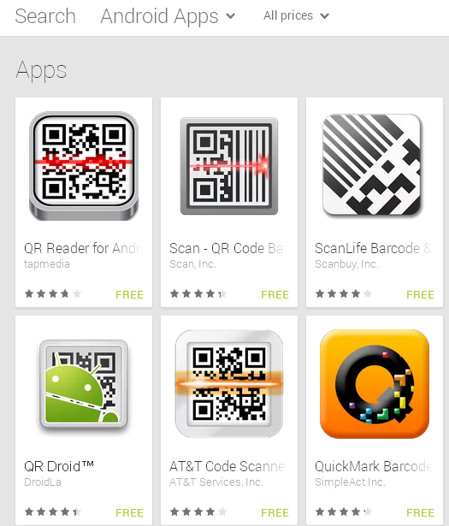
Examples of QR Reader Apps
There are hundreds of QR reader apps
Apple iOS: iPhone/iPad
Google: Android
Notes:
Add pictures of different QR apps

Slide 8
How to Create your own QR Code?
Find and copy the URL of desired information
Go to http://www.the-qrcode-generator.com/ (this is just one example of a QR generator)
Paste the URL in the designated box
Click to generate Code
Save the QR Code picture and print it

Slide 9
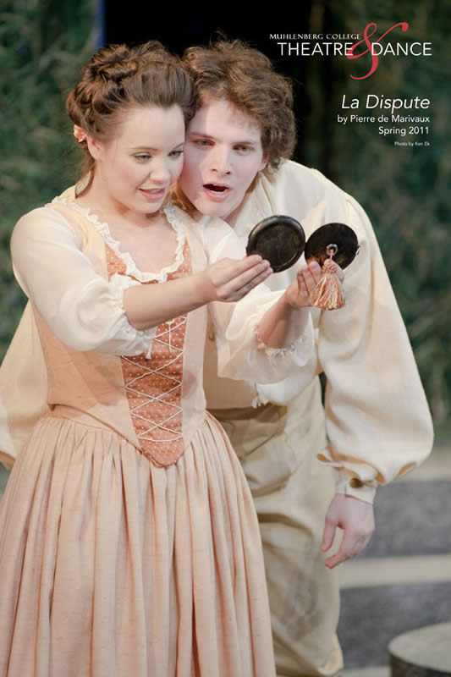
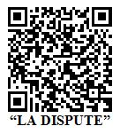
LLC Drama Exhibit

Slide 10
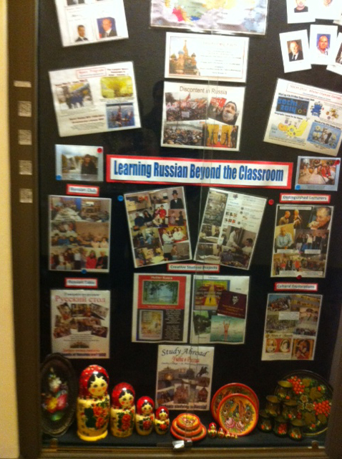
Ettinger Display Case

Slide 11
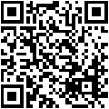
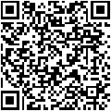
Ettinger Display Case QR codes
Alumni Voices (English) YouTube Video
Study Abroad St. Petersburg (Russian Audio)

Slide 12
Ideas for using QR codes
Possible Uses:
Program & Course Flyers
Language Tables
Departmental Events
Study Abroad Flyers

Slide 13

Google Earth St. Petersburg Tour

Slide 14
Blended Learning
Blended learning broadly defined:
Face-to-face classroom instruction combined with some form of technology-based teaching & learning

Slide 15
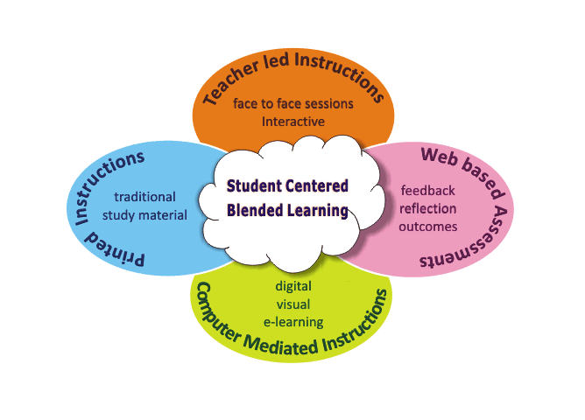
Blended/Hybrid Learning

Slide 16
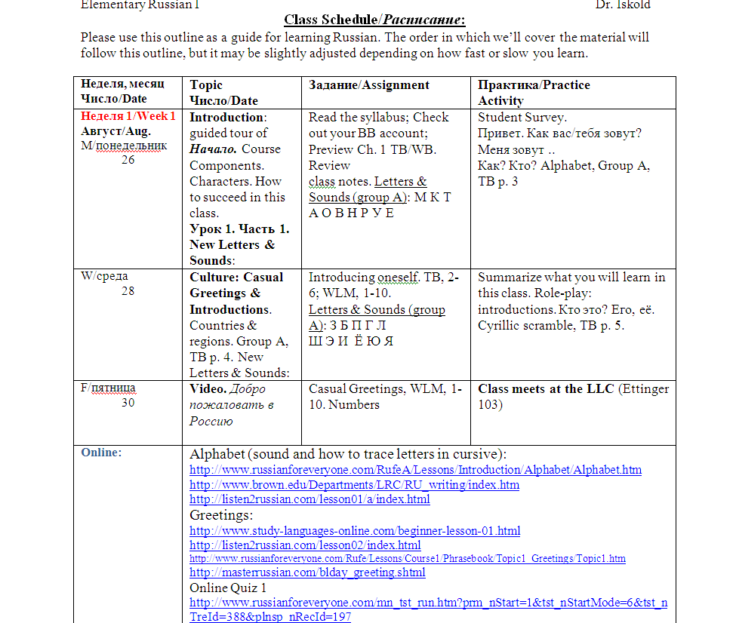
Blended Learning Example

Slide 17
Blended Learning
RUS 101 Examples
Alphabet (sound and how to trace letters in cursive):
http://www.russianforeveryone.com/RufeA/Lessons/Introduction/Alphabet/Alphabet.htm
http://www.brown.edu/Departments/LRC/RU_writing/index.htm
http://listen2russian.com/lesson01/a/index.html
Greetings:
http://www.study-languages-online.com/beginner-lesson-01.html
http://listen2russian.com/lesson02/index.html
http://masterrussian.com/blday_greeting.shtml
Online Quiz 1:
http://www.russianforeveryone.com/mn_tst_run.htm?prm_nStart=1&tst_nStartMode=6&tst_nTreId=388&plnsp_nRecId=197

Slide 18

Flipping the Classroom

Slide 19
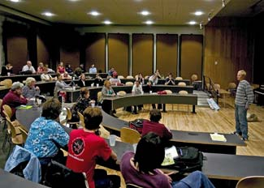
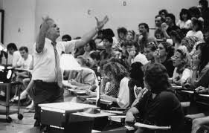
Traditional Classroom
Content is delivered by a professor

Slide 20
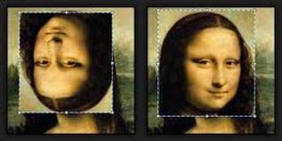
What does it mean to “Flip?”
Students receive content via the internet,
in the form of podcasts, YouTube videos,
and/or other online resources
Students use their computers or mobile devices (smartphones and tablets) to access the content

Slide 21
The Flipped Classroom IS:
Combination of direct instruction and constructivist learning
Environment that may enhance student responsibility
Opportunity to use more time for discussion and clarification
Facility for students to access content multiple times

Slide 22
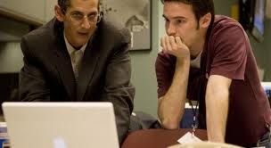
The Flipped Classroom is NOT
Replacing an instructor
with
Online Videos & Tutorials

Slide 23
Questions? Comments?

